Slide 1
Dr. Yifeng Zhu
ARM Cortex-M
Booting Process
Embedded Systems with ARM Cortex-M
Microcontrollers in Assembly Language and C
(Second Edition)
Visit book website: web.eece.maine.edu/~zhu/book/
Notes:
{{Pause=3}} In this short video, let’s understand the booting sequence of ARM Cortex-M processors.

Slide 2
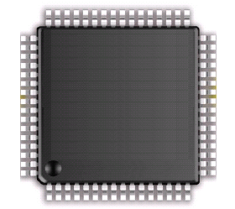
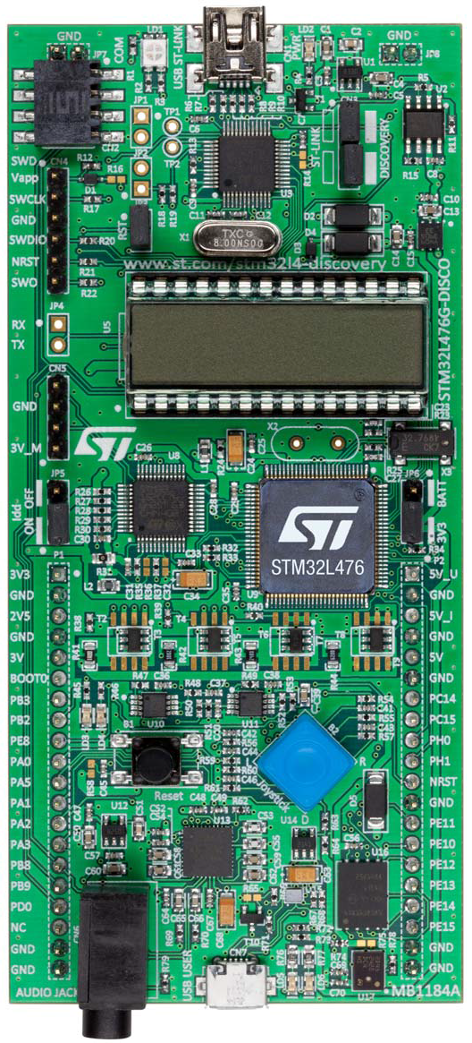
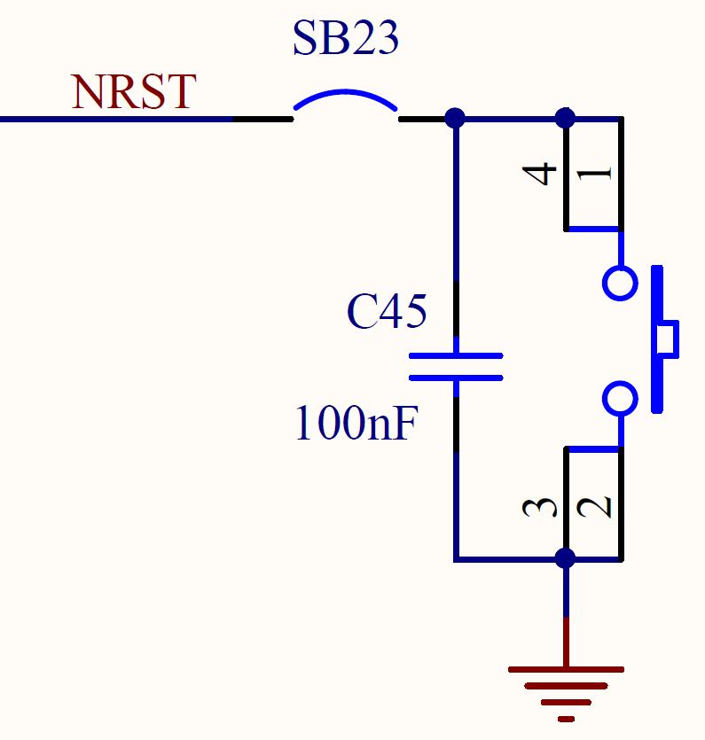

External Reset
Vdd
Pull-up
Resistor
(40KΩ)
NRST
ARM
Cortex-M4
Reset Button
Reset
Button
Improve EMS
Manually pull NRST pin low
STM32L4 Discovery Kit
Notes:
{{Pause=2}} A system reset, sets all registers to their reset values, except for the reset flags in the clock controller register (CSR), and the registers in the backup domain. A system reset can be generated by hardware or software. For example, if the NRST pin is pulled low, a system reset takes place. NRST pin is pulled, up, internally within the processor chip. If the reset button is pressed down, NRST pin is pulled low. When the reset button is released, the NRST pin becomes high again. A pulldown capacitor is added, in parallel with the reset button. This bypass capacitor is to improve the level of electromagnetic susceptibility (EMS) . Electromagnetic susceptibility of a device, is defined as, the ability to operate without fault, under electrical disturbances and noise. In other words, EMS is the level of tolerance to various forms of electromagnetic radiation. The bypass capacitor can remove high-frequency voltage signal from NRST pin, and thus reduce the transient circuit demand on the power supply unit.

Slide 3
Booting Process
Booting Sequence:
1. Read pins BOOT0 and BOOT1
and determine boot mode
2. Fetch MSP from address
0x00000000
3. Fetch PC from address
0x00000004
Notes:
{{Pause=2}} Let’s quickly review the interrupt vector table. {{Pause=1}} The first word in the memory contains the value to initialize the Main Stack Pointer (MSP). {{Pause=1}} The second word in the memory is a pointer to the function reset handler, which is the starting memory address, or called entry point, of the function reset handler. {{Pause=2}} Here is the booting process. When the processor boots, it first reads two pins, including pin boot 0, and pin boot 1. The processor determines the boot mode based on these two pins. {{Pause=1}} In the second step, the processor copies the value stored at the memory address 0 to the main stack pointer (MSP). Basically, the main stack pointer (MSP) is initialized in this step. {{Pause=1}} In the third step, the processor copies the value stored at the memory address 4 to the program counter (PC). Note that the program counter always holds the memory address of the next instruction to be executed by the processor. Therefore, immediately after the processor boots, the processor will start to execute the function reset handler. Typically, the reset handler performs some hardware initialization first, such as initialization of data segment and bss segment. Then, the reset handler calls the main() function and transfers the control to the main() function.

Slide 4
Booting Process
0x20001BB0
R0
R1
Stack
R2
R3
Booting Sequence:
1. Read pins BOOT0 and BOOT1
and determine boot mode
2. Fetch MSP from address
0x00000000
3. Fetch PC from address
0x00000004
R4
void main() {
...
}
R5
0x08001384
R6
R7
void Reset_Handler() {
...
main();
...
}
R8
0x08000268
R9
R10
...
R11
0x00000008
Bit 0 is 1, indicating Thumb state.
R12
0x00000004
0x08000269
Initialize MSP
0x08000269
R13 (SP)
0x00000000
0x20001BB0
0x20001BB0
Memory
address
Memory
content
R14 (LR)
Initialize PC
R15 (PC)
Registers
Notes:
{{Pause=2}} Here is a specific example. Suppose the word stored at the memory address 0 is, 2 0 0 0 1 B B 0, in hex, and the word stored at the memory address 4 is, 0 8 0 0 0 2 6 9, in hex. {{Pause=1}} The second word holds the memory address of the function reset handler. The memory address of the reset handler function in fact is 0 8 0 0 0 2 6 8, in hex, which is different from the second word stored in the memory. The least significant bit of the memory address of the reset handler function is, 0, however, the least significant bit of the second word in the memory is, 1. This is because ARM uses the least significant bit of the program counter to indicate whether the processor run in the Thumb mode or the ARM mode. Because ARM Cortex-M processors only support the Thumb mode, the least significant bit of the program counter should always be 1.
{{Pause=2}} After the processor determines the boot mode by reading pin boot 0 and pin boot 1, the processor copies the first word to the stack pointer register (SP). {{Pause=0.5}} Then, the processor copies the second word to the program counter register (PC).

Slide 5
Boot Mode
Boot1 | Boot0 | Boot Mode
x | 0 | Boot from main flash memory
0 | 1 | Boot from system memory (bootloader)
1 | 1 | Boot from embedded SRAM
Notes:
{{Pause=2}} Most Cortex-M processors support at least three different boot modes. The processor can boot from the in-chip flash memory, the system memory, or the in-chip SRAM. The code stored in the system memory is called bootloader. The bootloader is usually provided by chip manufacturers. A bootloader can upgrade the firmware inside the internal flash memory. {{Pause=0.5}} All STM32 microprocessors come with a pre-programmed bootloader, in a ready-only memory region (ROM). This ROM region is called system memory. However, sometimes, you want to develop a custom bootloader. For example, you may want to, encrypt the firmware, and put it on the internet so that customers can upgrade the firmware. In this case, you have to write a custom bootloader to decode the encrypted firmware.

Slide 6
Boot Mode
Boot1 | Boot0 | Boot Mode
x | 0 | Boot from main flash memory
0 | 1 | Boot from system memory
1 | 1 | Boot from embedded SRAM
0xFFFFFFFF
System
0.5 GB
0x1FFFFFFF
0xE0000000
Option Bytes
External Device
0x1FFF77FF
ROM region reserved to bootloaders
System memory
(bootloader)
1 GB
0xA0000000
External RAM
0x1FFF0000
Reserved
1 GB
0x60000000
Peripheral
0x080X0000
0.5 GB
Internal Flash
0x40000000
Internal SRAM
0x08000000
0.5 GB
Reserved
0x20000000
0.5 GB
Code
Alias to flash, system memory or SRAM
0x00000000
0x00000000
One Byte (8 bits)
Notes:
{{Pause=2}} Here is the memory map of ARM Cortex-M processors. The address range of each memory region is fixed. Let’s take a look at the code region. {{Pause=0.5}} The code region ranges from 0 to 1FFFFFFF, in hex. The top area is the ROM region reserved to store bootloaders. {{Pause=1}} The middle area is the in-chip flash memory. {{Pause=1}} The bottom area is an area that can be physically mapped to the internal flash, system memory, and internal SRAM. The starting address of internal flash memory, the system memory, and internal SRAM is also fixed. Specifically, the starting address of internal flash is 0 8 0 0 0 0 0 0, in hex, and the address of the system memory starts at 1 F F F 0 0 0 0, in hex.
{{Pause=1}} Now, let’s look at the boot mode. The boot mode are determined by the voltage applied to pin boot 1 and pin boot 0.

Slide 7
Boot Mode
Boot1 | Boot0 | Boot Mode
x | 0 | Boot from main flash memory
0 | 1 | Boot from system memory
1 | 1 | Boot from embedded SRAM
0xFFFFFFFF
System
0.5 GB
0x1FFFFFFF
0xE0000000
Option Bytes
External Device
0x1FFF77FF
ROM region reserved to bootloaders
System memory
(bootloader)
1 GB
0xA0000000
External RAM
0x1FFF0000
Reserved
1 GB
0x60000000
Peripheral
0x080X0000
0.5 GB
Internal Flash
0x40000000
Physical remap:
e.g. map 0x08000000 to 0x00000000
Internal SRAM
0x08000000
0.5 GB
Reserved
0x20000000
0.5 GB
Code
Alias to flash
0x00000000
0x00000000
One Byte (8 bits)
Notes:
{{Pause=2}} If pin boot 0, is connected to the ground, the processor will boot from the internal flash memory. If pin boot 0 is grounded, the processor will physically map the internal flash memory to the button area. {{Pause=1}} For example, the memory address 8000000 is physically mapped to the memory address 0. In other words, the Flash memory contents can be accessed starting from address 0 or, 8000000. {{Pause=1}} As discussed previously, when the processor boots, it always fetch the value of the stack pointer and program counter from the memory address 0 and 4, respectively. Because the internal flash memory is physically remapped to the starting address 0, the flash memory is in fact the boot memory.

Slide 8
Boot Mode
Boot1 | Boot0 | Boot Mode
x | 0 | Boot from main flash memory
0 | 1 | Boot from system memory
1 | 1 | Boot from embedded SRAM
0xFFFFFFFF
System
0.5 GB
0x1FFFFFFF
0xE0000000
Option Bytes
External Device
0x1FFF77FF
ROM region reserved to bootloaders
System memory
(bootloader)
1 GB
0xA0000000
External RAM
0x1FFF0000
Reserved
1 GB
0x60000000
Peripheral
0x080X0000
0.5 GB
Internal Flash
0x40000000
Physical remap:
e.g. map 0x1FFFX000 to 0x00000000
Internal SRAM
0x08000000
0.5 GB
Reserved
0x20000000
0.5 GB
Code
Alias to system memory
0x00000000
0x00000000
One Byte (8 bits)
Notes:
{{Pause=2}} When pin boot 1 is low, and pin boot 0 is high, the system memory is physically mapped to the bottom area. {{Pause=1}} When the processor fetches the value of the program counter from memory address 4, the processor in fact fetches the value from the system memory. As result, the system memory is chosen as the boot memory. In this boot mode, processor can reprogram the flash memory or perform the device firmware upgrade.

Slide 9
Boot Mode
Boot1 | Boot0 | Boot Mode
x | 0 | Boot from main flash memory
0 | 1 | Boot from system memory
1 | 1 | Boot from embedded SRAM
0xFFFFFFFF
System
0.5 GB
0x1FFFFFFF
0xE0000000
Option Bytes
External Device
0x1FFF77FF
ROM region reserved to bootloaders
System memory
(bootloader)
1 GB
0xA0000000
External RAM
0x1FFF0000
Reserved
1 GB
0x60000000
Peripheral
0x080X0000
0.5 GB
Internal Flash
0x40000000
Internal SRAM
0x08000000
0.5 GB
Physical remap:
e.g. map 0x20000000 to 0x00000000
Reserved
0x20000000
0.5 GB
Code
Alias to SRAM
0x00000000
0x00000000
One Byte (8 bits)
Notes:
{{Pause=2}} When both pin boot 1 and pin boot 0 are high, the internal SRAM is physically mapped to the bottom area. {{Pause=0.5}} The memory address 20000000 is physically mapped to the memory address 0. {{Pause=0.5}} Therefore, the processor boots from SRAM.

Slide 10
FAQ
How to set up the boot mode?
PCB design
How to place the code to the boot memory (internal flash, system memory, internal SRAM)
Linker Script
How are data and code sections merged?
Where should each section be placed in the memory?
How to set values in memory address 0 and address 4?
startup_xxx.s
Stack_Size EQU 0x00000400
AREA STACK, NOINIT, READWRITE, ALIGN=3
Stack_Mem SPACE Stack_Size
__initial_sp
...
__Vectors DCD __initial_sp ; Top of Stack
DCD Reset_Handler ; Reset Handler
startup_stm32lxx_md.s
Notes:
{{Pause=2}} Here, we answer three frequently asked questions. First, how to set up the boot mode? The boot mode is determined by the PCB design, not by the processor. For the STM32L4 discovery kit, the default boot memory is the internal flash because pin boot 0 is connected to the ground. {{Pause=1}} Second, how to place code to the boot memory? When the linker combines object and library files into a single executable, a linker script provides the linker two critical types of instructions regarding, how data and code sections are merged, and where each section should be placed in the memory. Programmers can modify the linker script to place the code in the target boot memory. {{Pause=1}} Third, how to set values stored at memory address 0 and 4? The short answer is the startup code. The startup code, such as the start up assembly file, sets these values. For example, the STM32 startup assembly file defines the stack size, the stack pointer’s initial value, and the program counter’s initial value.

Slide 11
What does the startup code do?
Assume the project runs in flash
The bootloader (startup_xxxx.s) will perform the following:
Set up the stack and heap region
Pace the memory address of the stack at the beginning of the interrupt vector
Set up the rest of the interrupt vector
Copy RW data session from Flash to SRAM
Copy ZI data session from Flash to SRAM

Slide 12
Flash Memory Layout
0x080XFFFF
ZI Data
Zero Initialized
RW Data
Read-Write
0xFFFFFFFF
RO Data
System
0.5 GB
0x1FFFFFFF
Read-only
0xE0000000
Option Bytes
External Device
0x1FFF77FF
Code
System memory
(bootloader)
1 GB
0xA0000000
External RAM
0x1FFF0000
…
Reserved
1 GB
Interrupt vector
0x60000000
Peripheral
0x080X0000
NMI_Handler
0.5 GB
Internal Flash
Reset_Handler
0x40000000
Internal SRAM
0x08000000
MSP
0.5 GB
0x08000000
Reserved
Internal Flash
0x20000000
0.5 GB
Code
Alias to flash, system memory or SRAM
0x00000000
0x00000000

Slide 13
Memory Layout of Code
Section | Content | Memory Region at Run-time
.isr_vector | Stack address, interrupt address vector | Code (Flash)
.text | Program code, some constants | Data (Flash)
.rodata | Constant data, strings | Code (Flash)
.data | Global initialized variables, local initialized static variables | Data (RAM) and Code (Flash)
.bss | Global un-initialized/zero-initialized variables, local un-initialized/zero-initialized static variables | Data (RAM)
heap | Dynamically allocated variables | Data (RAM)
stack | Local non-static variables | Data (RAM)

Slide 14
Execution Image
0x080XFFFF
ZI Data
Program are stored in the code section.
Constants/literals are in Read-Only section following the code.
Global initialized variables are in Read-Write section.
Global uninitialized variables are in Zero-Initialized section.
Some variables are stored in processor’s registers for performance.
int a, b;
int c = 271, d = 275;
int f[] = {10,11,12,13}
int main (void){
uint32_t i;
char str1[32];
char str2[] = "0123456789";
int32_t sum = -1;
uint32_t array[] = {1, 2, 3, 4, 5};
uint32_t e = 12345;
for (i = 0; i < 5; i++){
sum += array[i]*2 + f[i] + e;
str2[i] = str1[i];
}
while(1);
}
RW Data
RO Data
Code
…
Interrupt vector
NMI_Handler
Reset_Handler
represented by a register
MSP
Internal Flash
0x08000000

Slide 15
Execution Image
0x080XFFFF
0x3FFFFFFF
ZI Data
int a, b;
int c = 271, d = 275;
int f[] = {10,11,12,13}
int main (void){
uint32_t i;
char str1[32];
char str2[] = "0123456789";
int32_t sum = -1;
uint32_t array[] = {1, 2, 3, 4, 5};
uint32_t e = 12345;
for (i = 0; i < 5; i++){
sum += array[i]*2 + f[i] + e;
str2[i] = str1[i];
}
while(1);
}
RW Data
RO Data
Stack
Code
Reset_Handler() copies data from Flash to SRAM.
Free Space
…
Interrupt vector
Heap
NMI_Handler
ZI Data
Reset_Handler
represented by a register
RW Data
MSP
Internal Flash
0x08000000
0x20000000
Internal SRAM

Slide 16
Execution Image
Most local variables are stored in the stack
Subroutine is responsible for initialize local variables in stack
0x080XFFFF
0x3FFFFFFF
ZI Data
Subroutine copies data from RO to initialize stack.
int a, b;
int c = 271, d = 275;
int f[] = {10,11,12,13}
int main (void){
uint32_t i;
char str1[32];
char str2[] = "0123456789";
int32_t sum = -1;
uint32_t array[] = {1, 2, 3, 4, 5};
uint32_t e = 12345;
for (i = 0; i < 5; i++){
sum += array[i]*2 + f[i] + e;
str2[i] = str1[i];
}
while(1);
}
RW Data
RO Data
Stack
Code
Reset_Handler() copies data from Flash to SRAM.
Free Space
…
Interrupt vector
Heap
NMI_Handler
ZI Data
Reset_Handler
represented by a register
RW Data
MSP
Internal Flash
0x08000000
0x20000000
Internal SRAM

Slide 17
A Word of Warning
Image could be different due to the optimization made by compiler
Compiler often optimize the code to improve the computation efficiency or reduce the code size
Using registers to replace some variables
Remove declared but unused variables
Constant folding and propagation (replacing 5 + 3 with 8)
Register allocation
Dead code elimination
Loop unrolling

